Slide 1
Exploring Global Socio-Economic Trends
Presented by,
HANUMANTHA RAO VULLI
RAJASEKHAR PONNURU
SIDDHARTHA GURRAM
PADMAJA KODATI

Slide 2
agenda
Introduction 3
Data Abstraction 5
Task Abstraction 9
Implementation using tool 12
Result for analysis 15
Project management 30
References 31

Slide 3
Introduction
In this project, we have taken three datasets. First one consists of population of the dataset, second one consists of global bloodtype data, and third one consists of global GDP.
We have merged these three datasets and done Vizualization on the merged dataset using different tools such as Tableau, D3.js, and PowerBI. Through this project, we got insight into the world of scientific data vizualization.

Slide 4
Work-flow diagram with explanation
Exploring the Dataset
First, we gathered the datasets from Kaggle according to our requirements and merged the datasets based on the similarities they have. Then we did data cleaning which means removing the unwanted data from all the datasets. Now on the final dataset we executed different visualizations on Tableau, Vizhub and powerBI. In the end, we have attached all the visualizations performed on these 3 tools. Also, we have created a webpage which has the links that redirect us to all the visualizations that we worked on.
Merging the Dataset
Imputation of Dataset
Using Tools for Visualization
Result Analysis and Webpage

Slide 5
Data Abstraction
Dataset | Attributes | Type
1. population_by_country_2020 | Country, Population, Yearly Change, Net Change, Density, Land Area, Migrants (net),Fert. Rate, Med. Age, Urban Pop %,World Share | Table
2. global-blood-type-distribution | Country, Population, O+, A+, B+, AB+, O-, A-, B-, AB- | Table
3. list-of-countries-by-gdp-sector-composition | Index Number , Rank, Country, GDP (millions of $),Agriculture GDP, Rank,% of GDP, Industry GDP, Rank,% of GDP, Services GDP, Rank,% of GDP, Year GDP ,Year Sector | Table

Slide 6
Detailed description of datasets
1. population_by_country_2020: This dataset consists of information related to the world population with respective to each country in the year 2020. It also has important attributes like land area, density and urban population which is useful to focus not only on population but also on other key areas.
2. global-blood-type-distribution: This dataset focuses on the medical sector which has all the countries with their population and their blood groups.
3. list-of-countries-by-gdp-sector-composition: This dataset focuses on the finance sector which has information about the country’s rank and their gdp with respective to different domains like agriculture, industry etc.

Slide 7
Design of features for the datasets
population_by_country_2020
.global-blood-type-distribution
Joined using Country column
list-of-countries-by-gdp-sector-composition
Updated_Population_Bloodtype_Dataset
Joined using Country column
Updated_Population_Bloodtype_gdpDataset

Slide 8
Data transformation
The datasets population_by_country_2020 and global-blood-type-distribution are joined using common column ‘Country’ and the updated dataset is generated which is population-bloodtype dataset.
Now, the list-of-countries-by-gdp-sector-composition dataset is joined with the updated dataset using the common column Country for these both and the final dataset is generated which is population-Bloodtype-gdp dataset

Slide 9
Task Abstraction
Targets Outliers: Finding outliers using Scatter Plot Trends: Showing Trends using Line Chart Comparisons: Doing comparison of population over the yearly growth using Bar Chart
Actions Analyze :- Analyzing the merged dataset Present: Presenting data using different Idioms Derive: Derive data using three different datasets

Slide 10
Work-flow diagram
Visualization
Tableau
D3.JS
powerBI
Symbol map
Stacked Bar chart
Pie chart
Bar chart
Scatter plot
Pie chart
Packed bubble
Bar chart

Slide 11
Explanation for workflow diagram
We have shown visualizations in 3 different tools which are Tableau, d3.js and powerBI. We also explored various charts.
In Tableau, we performed tasks and displayed the visualizations for stacked bar charts, symbol maps and Packed bubble.
In d3.JS, we performed tasks and displayed the visualizations for bar charts and pie charts.
In powerBI, we performed tasks and displayed the visualizations for bar charts, scatter plot and pie charts.

Slide 12
Implementation using tool: Tableau
It is a data visualization tool through which so many things can be done. This tool Lets USERS create very interactive and DYnamic ViSualizations. To understand it and work on it, we don't need technical understanding. A person with normal understanding of Data, rows, and columns would be able to viSualize using this tool.

Slide 13
Implementation using tool: D3.js
It is the great tool for visualization using WEB browser. We use this in vizhub tool and use languages like html, css, AND JAVA SCRIPT to do visualization. IT offers flexibility AND IS used for building data visualization on the web.

Slide 14
Implementation using tool: PowerBI
Powerbi is a tool provided by the microsoft. It works on different areas like visualization, REPORTING ETC. It provides different types of graphs such as line chart, bar chart, scatter plot for the visualization. It is very interactive and dynamic tool.

Slide 15
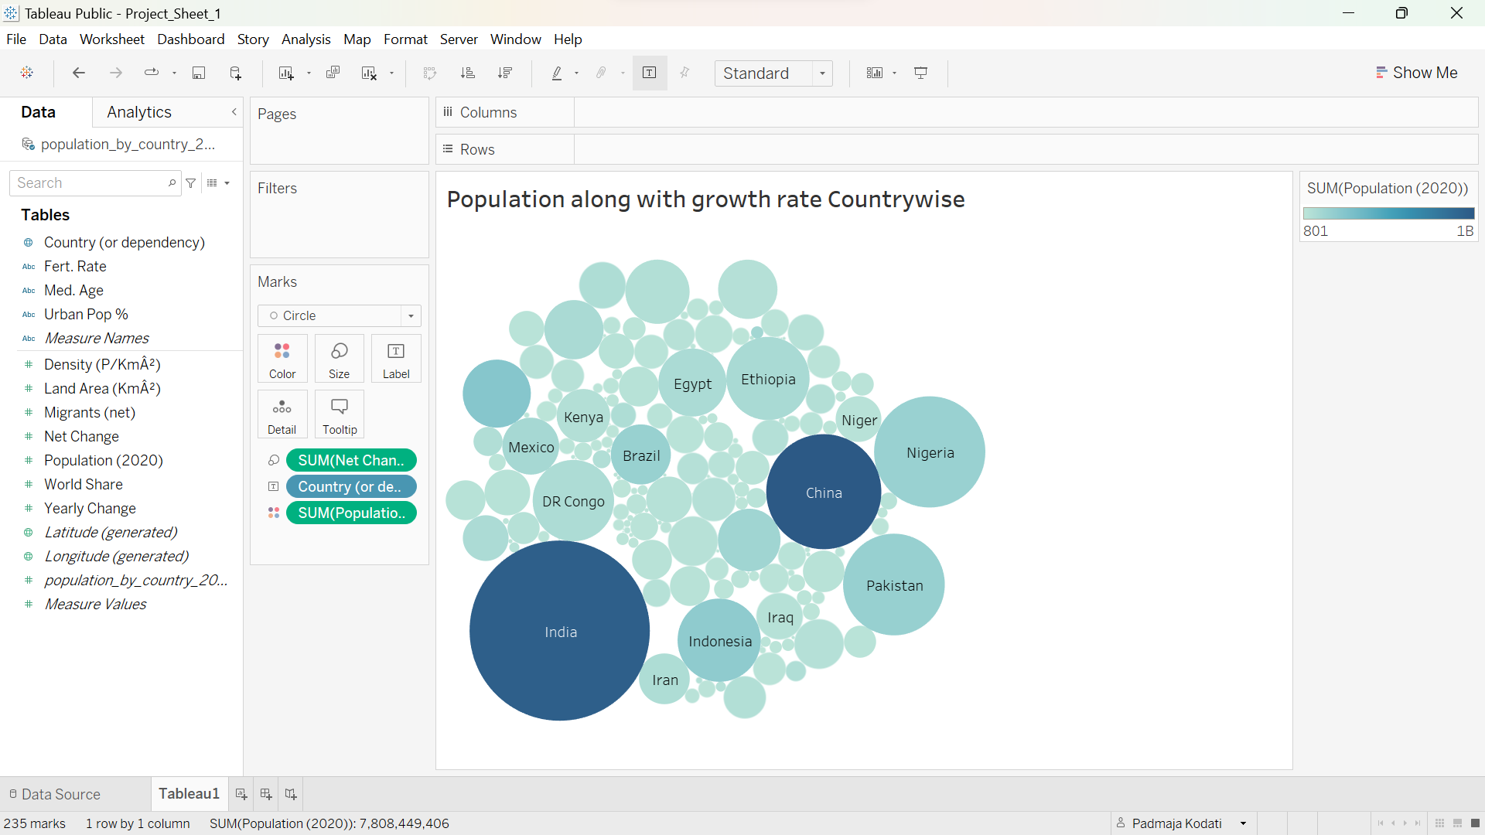
Result for analysis: Tableau
This snapshot represents the packed bubble graph for the attributes Population, Net Change and Country where Population is the color. More dark the color, more population. Size of the bubble is Net change. Greater the size of bubble more is Net Change.

Slide 16
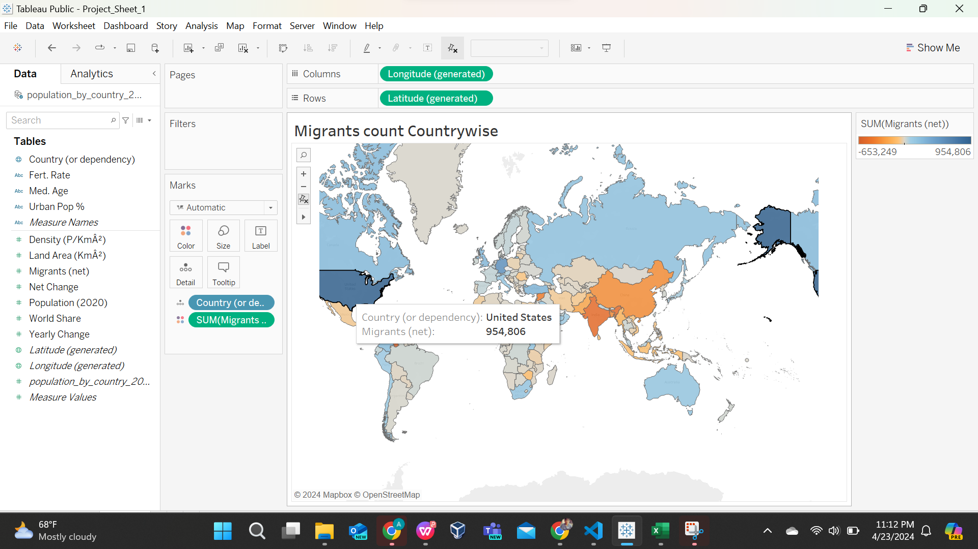
Result for analysis: Tableau
This is snapshot of Symbol Map in which I have put Migrant workers' growth as the color and took country. So by clicking on every country we will be getting to know howmany migrant workers have migrated.

Slide 17
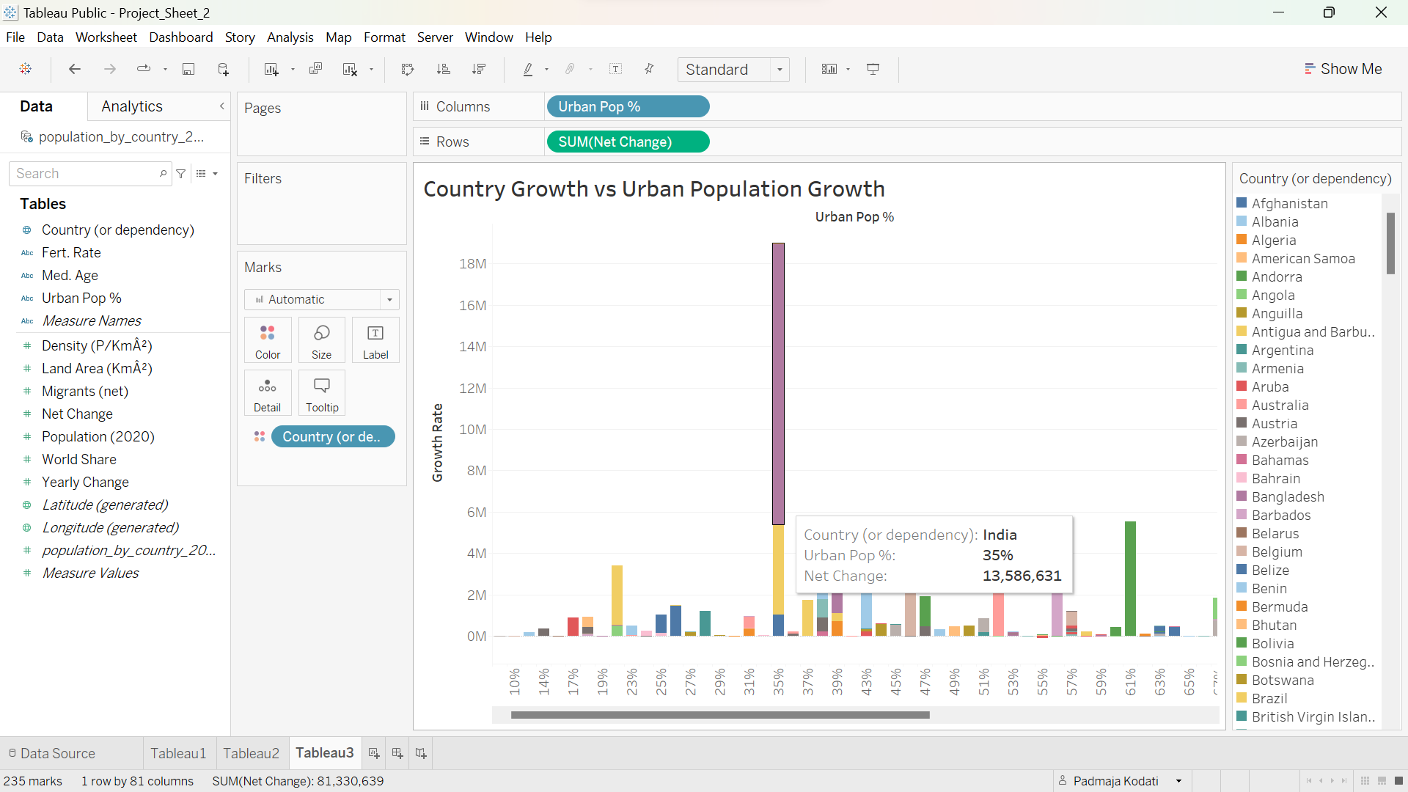
Result for analysis: Tableau
This is the stacked bar chart between the population growth and urban population growth for every specific country in the world.

Slide 18
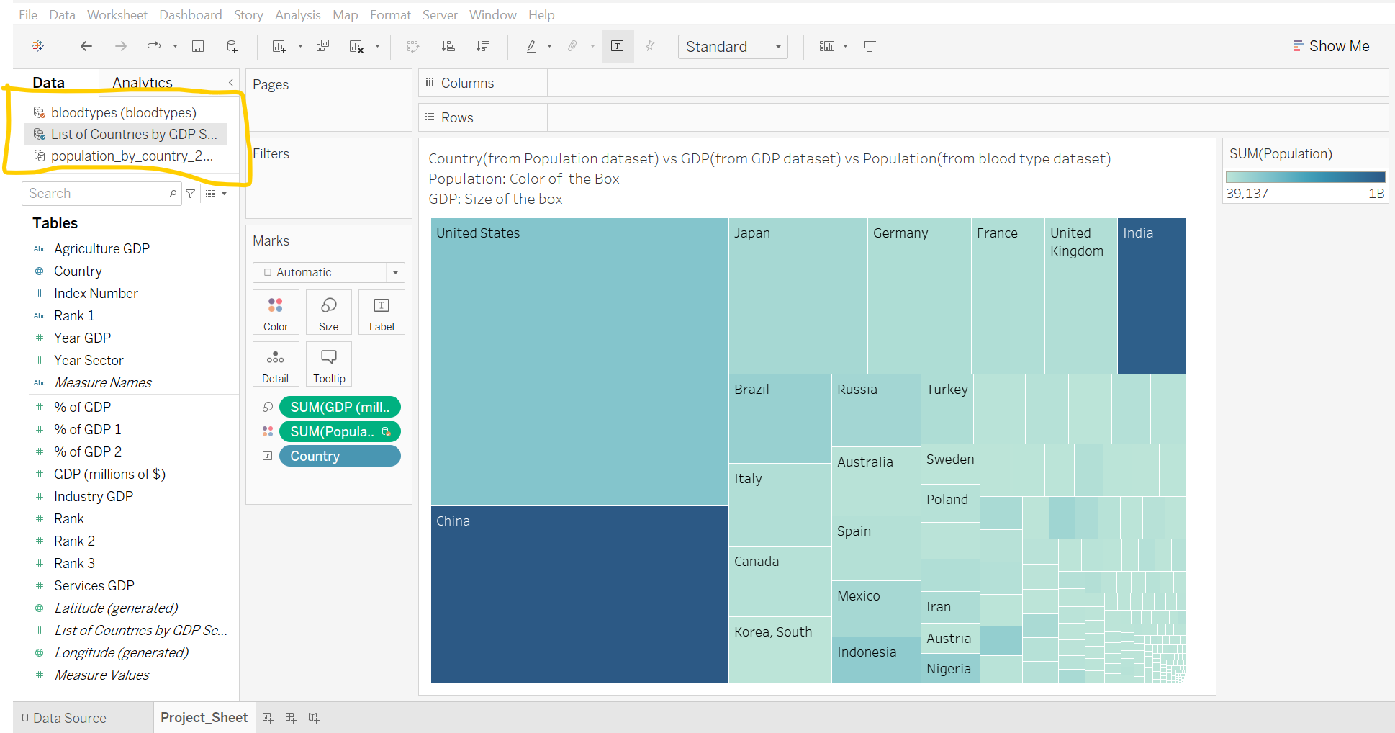
Result for analysis: Tableau
Here as we can see that we have highlight all the three datasets we are using and merging. Then I have used this graph for the visualization of attributes from all three datasets and explained in the diagram itself.

Slide 19
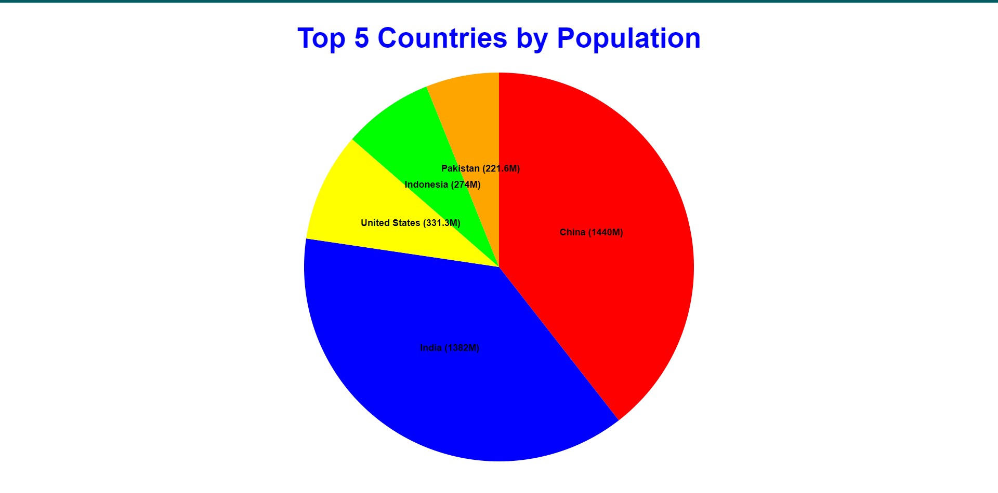
Result for analysis: D3.js
This is visualization from D3.js in which I have done for the pie chart for the top 5 countries in the world by population according to the dataset we have used and have provided the percentage those countries contribute to.

Slide 20
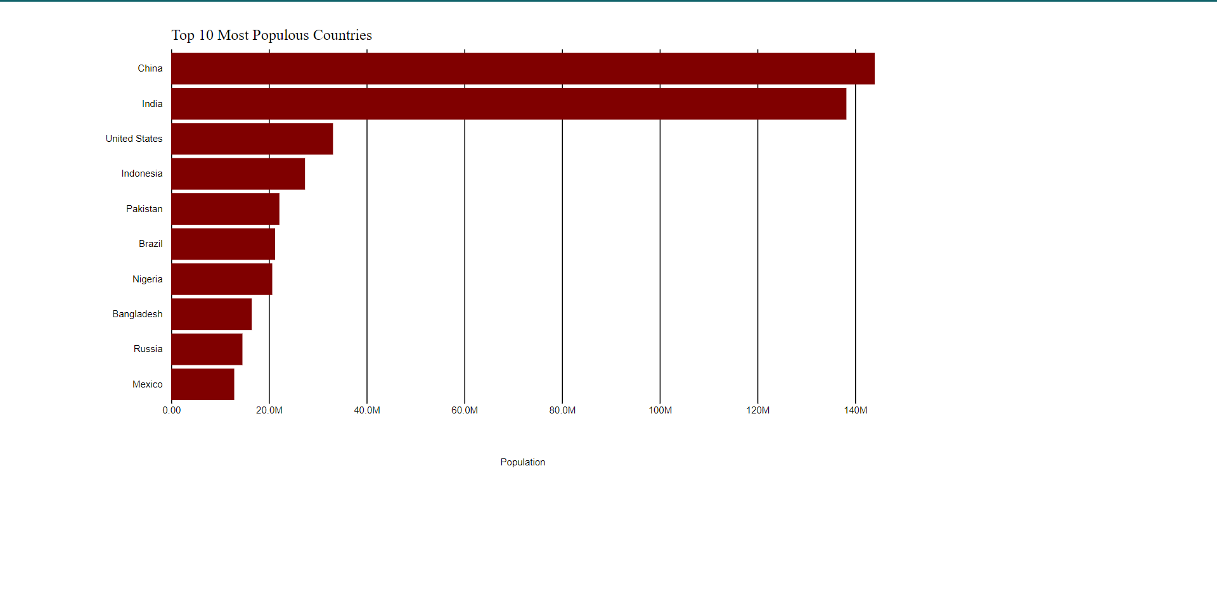
Result for analysis: D3.js
This is the bar chart which is doing the comparison for top 10 countries population wise and showing that which country has how much population on the scale and what is the comparison ratio.

Slide 21
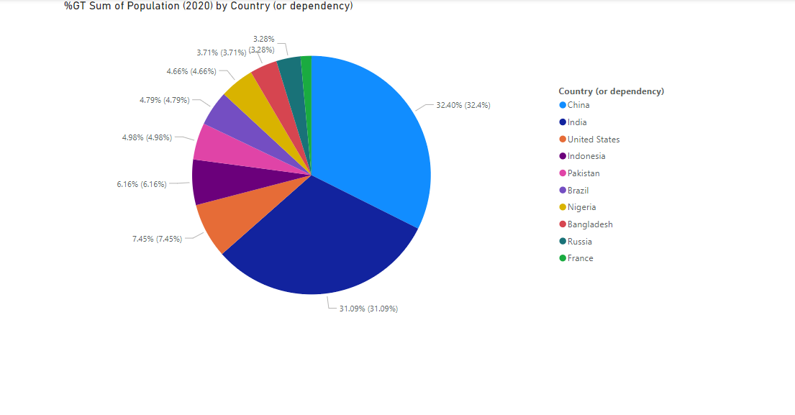
Result for analysis: PowerBI
This is being done in PowerBI where I have visualized in the same way as I have done in the D3.js but here the way it is visualized is different which shows that it can be done in many ways.

Slide 22
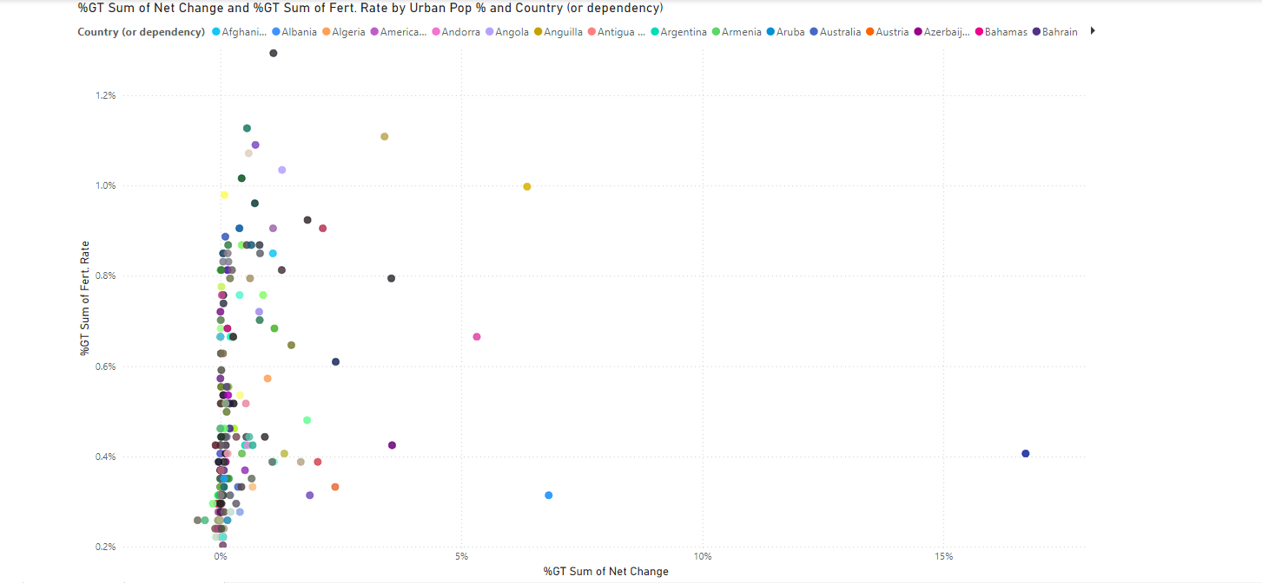
Result for analysis: PowerBI
This is the scatter plot which is designed in PowerBI. In this we have taken countries as value and trying to find the fertility rate and growth change relationship for every country.

Slide 23
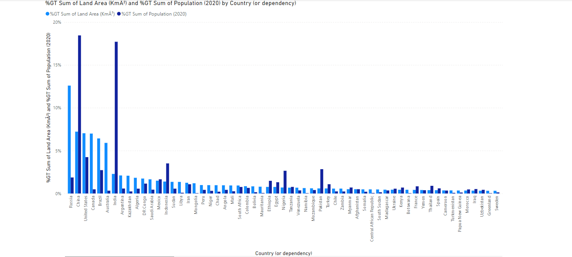
Result for analysis: PowerBI
This is the bar graph which is done in PowerBI. It is comparing being the Land Area and Population of a country, It is showing that which country has more population but less land area than others which is a way to analyze things well.

Slide 24
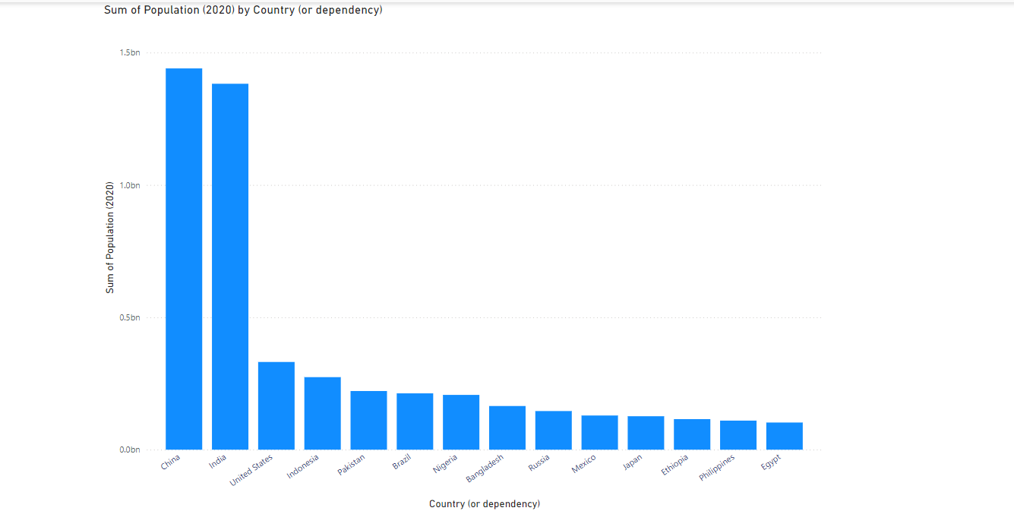
Result for analysis: PowerBI
This is designed in same way as in Tableau just that for same visualization we have used different tool to find out the differences and similarities between the different features of the tools and understand which one can give better results going forward.

Slide 25
Links for visualization
tABLEAU
https://public.tableau.com/app/profile/padmaja.kodati/viz/Project_Sheet_1_17139311229410/Tableau1?publish=yes
https://public.tableau.com/app/profile/padmaja.kodati/viz/Project_Sheet_2/Tableau2?publish=yes
https://public.tableau.com/app/profile/padmaja.kodati/viz/Project_Sheet_3/Tableau3?publish=yes
D3.JS
https://vizhub.com/PadmajaKodatii/14a46b5aa012473380c043c6d8a5fc86?edit=files&file=index.html
https://vizhub.com/PadmajaKodatii/6135db48b0e442c6b5dca84e54a6a2cf?edit=files&file=index.html
Power bi
https://myunt-my.sharepoint.com/:u:/g/personal/padmajakodati_my_unt_edu/EWf03AnSoLxEnNHtuVgLwgwB1lYLj3iaLgScS_1cjj1WdQ?e=WmcC29

Slide 26
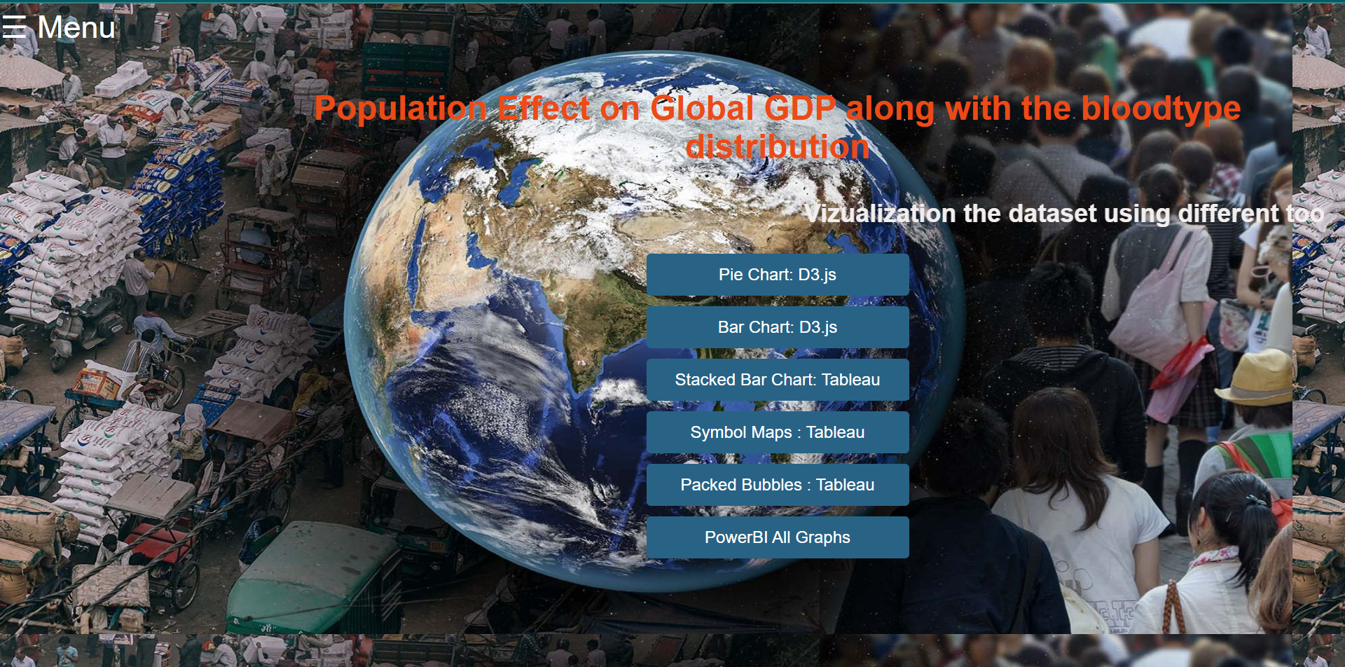
WebPage Visuals: HomePage

Slide 27
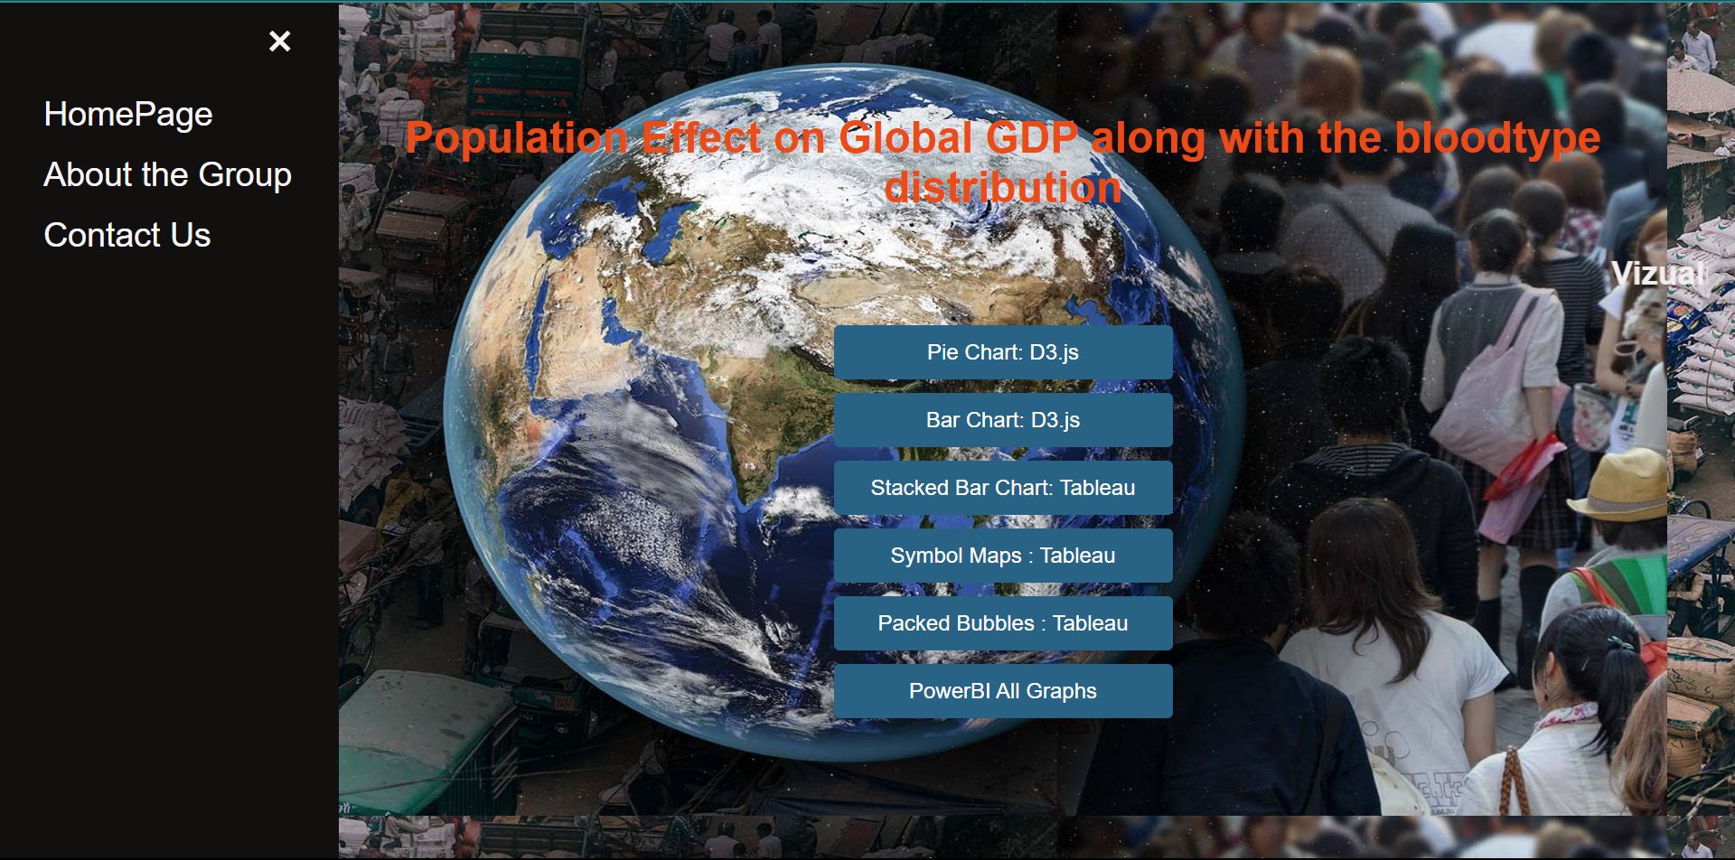
WebPage Visuals: After Clicking on Menu

Slide 28
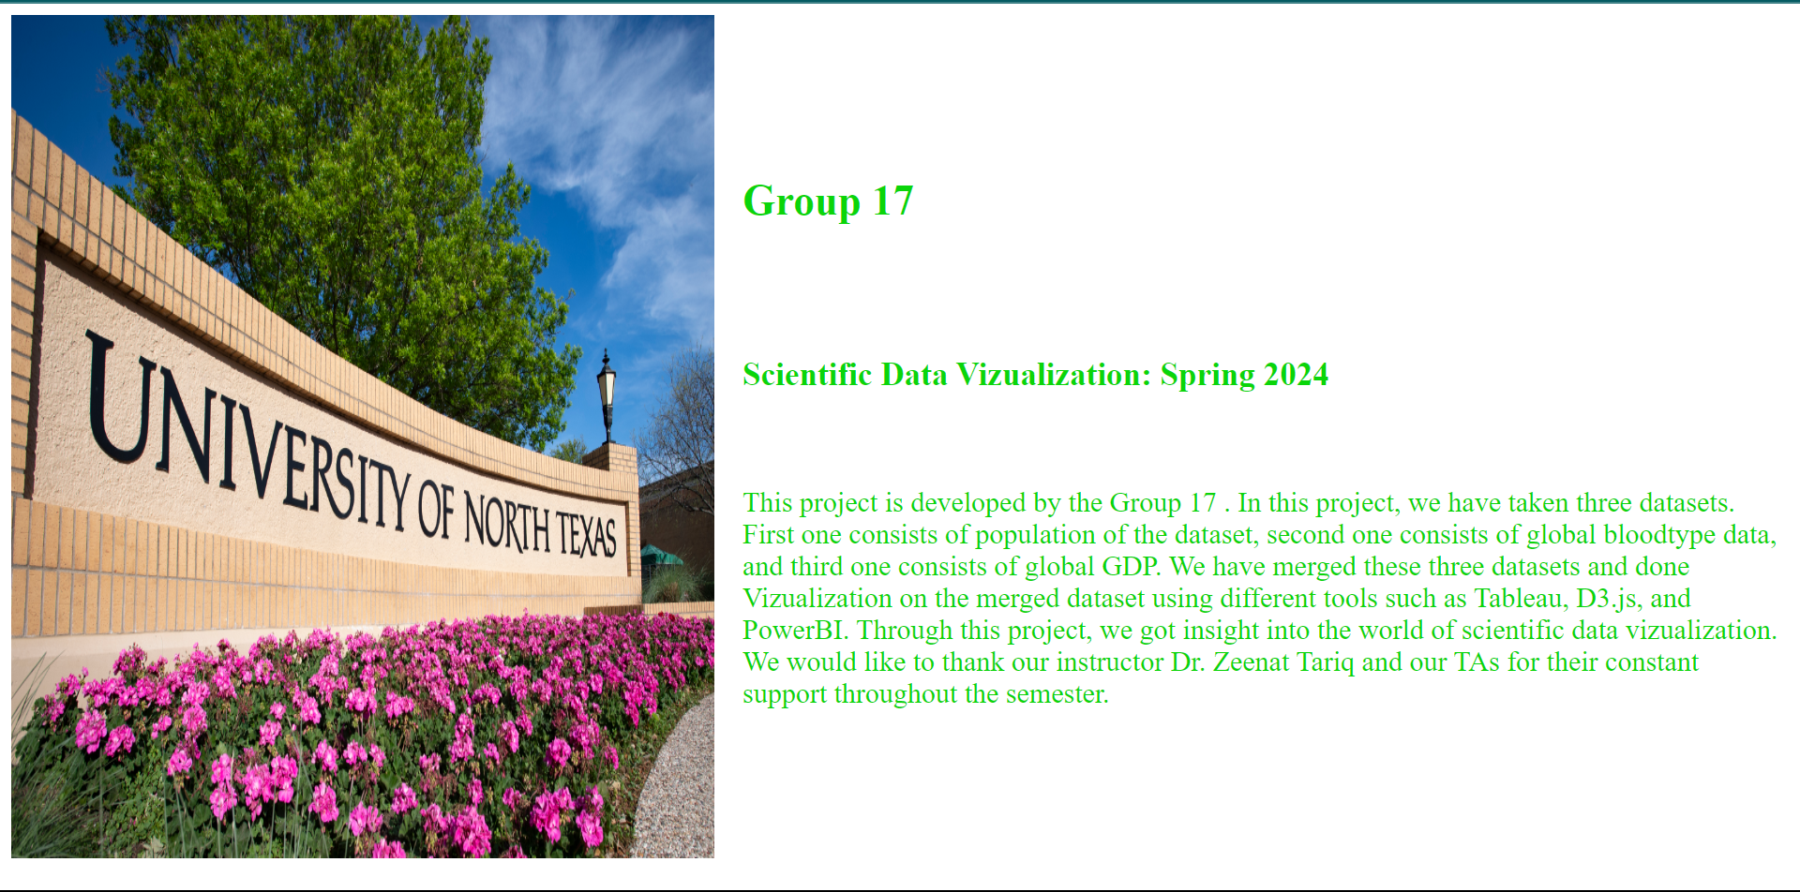
WebPage Visuals: About the Group

Slide 29

WebPage Visuals: Contact Us

Slide 30
Work management
Name | Contribution | Features |  | Description
HANUMANTHA RAO VULLI | 25% | Tableau | D3.JS
RAJASEKHAR PONNURU | 25% | Website design | powerBI
SIDDHARTHA GURRAM | 25% | D3.JS | presentation
PADMAJA KODATI | 25% | powerBI | Website design

Slide 31
References
World Health Organization. “Global Health Observatory (GHO) data.” Retrieved from https://www.cdc.gov/gho/data.html
https://www.kaggle.com/datasets/rajkumarpandey02/list-of-countries-by-gdp-sector-composition
https://www.kaggle.com/datasets/kamilenovaes/global-blood-type-distribution
https://www.kaggle.com/datasets/tanuprabhu/population-by-country-2020/data

Slide 32
thank you

